Slide 1

“To-Do List”
Task - 3

Slide 2
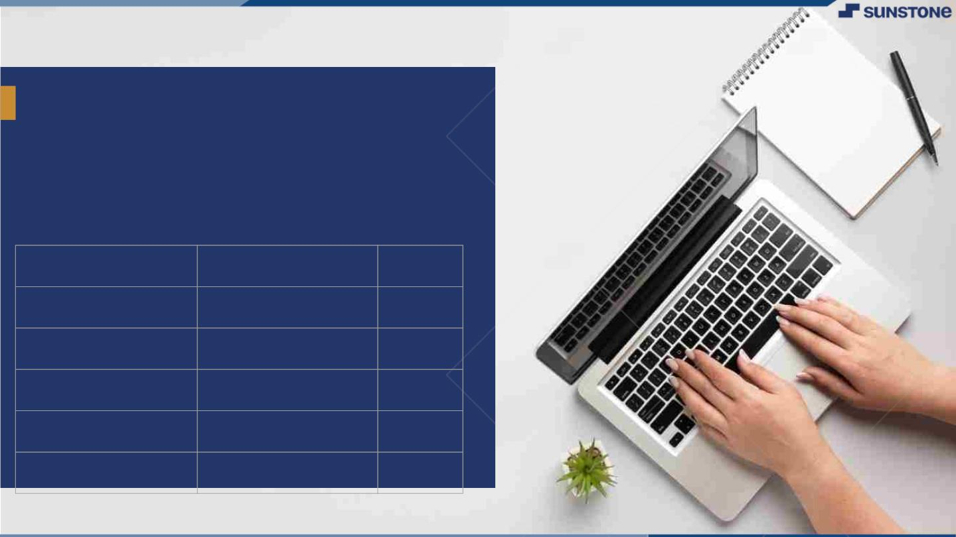
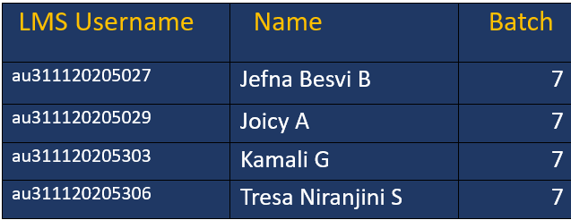
To-Do List
▪
A to-do list serves as the cornerstone for organized execution. It acts as a dynamic roadmap, guiding the team through tasks, deadlines, and priorities.
LMS Username
Name
Batch
au311120205012
Anto Vishvack M
16
au311120205018
Calvin Jacob Fernando
16
au311120205028
Jenish Richard
16
au311120205030
Joseph Aron Babu Pappachan
16

Slide 3
Task 3 :: Frontend Creation
Create various Front End Programs
Draw and design a uniform front end code for “To-Do-List”
Draw and design a interactive front end code for “To-Do-List”
Evaluation Metric
100% Completion of the above tasks
Learning Outcome
Developing complicated UI using HTML components
Using props drilling and context to pass variables
Getting familiar with different type of api calls
Handling different input data

Slide 4
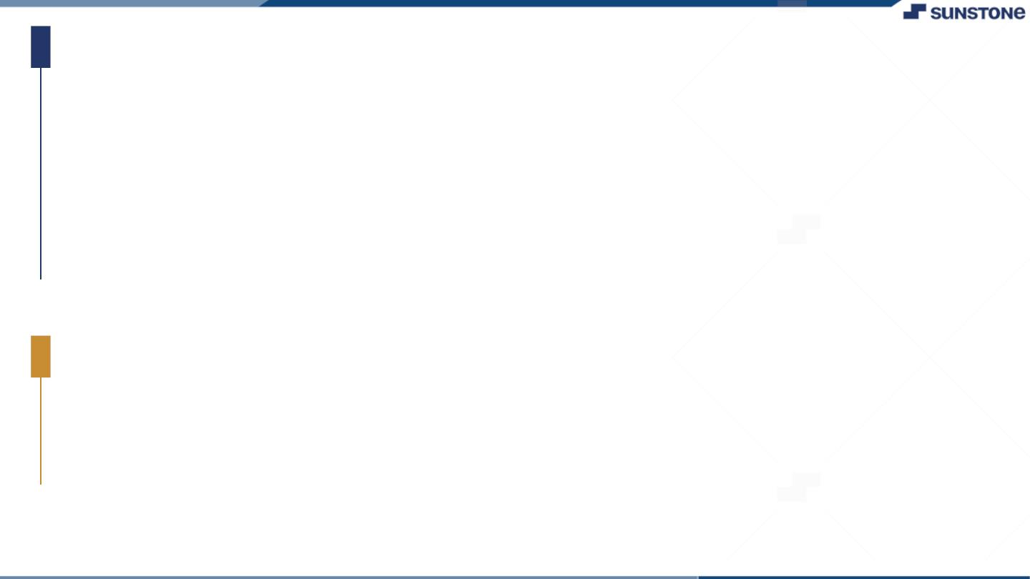
Step-Wise Description
Create a uniform front end for a to-do list with basic functionalities.
Add features like marking tasks as complete, sorting, and filtering.
Practice props drilling to pass data between parent and child components.
Learn and practice different API calls using tools like Fetch API or Axios.
Integrate API calls into your front end to retrieve and display data.
Summary of Task3
Set up development environment (HTML, CSS, JavaScript).
Learn and practice different API calls (Fetch API, Axios).
Handle various input data in forms (HTML, JavaScript).
Handle different data types and scenarios, such as text input, checkboxes, and radio buttons.

Slide 5
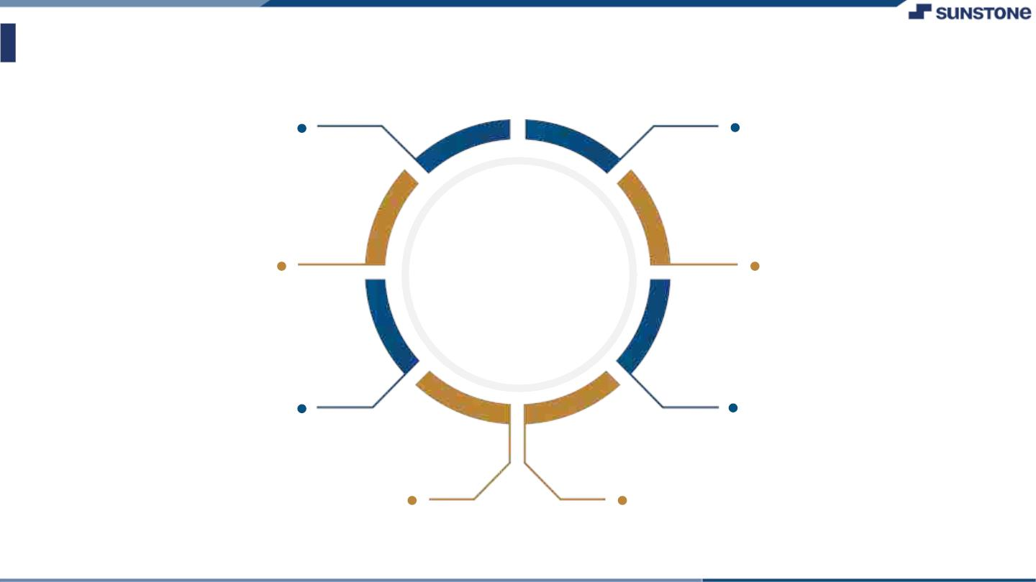
Assessment Parameter
Create folder structure for HTML application
Render Conditional components
Write Functions for event handling
Check-List
Overall UI of the project
Handling broken links
Optimizing render cycle

Slide 6

Submission Github
https://github.com/tresaniranjini/NM-LICET-IT-GROUP7

Slide 7


